Slide 1
Wirelessly Charged
Nursery Light
Team Lead / Client Interaction - Josh Holloway
Electrical Lead - Tommy Youhn
Tester - William Snyder
Facilitator / Designer - Logan Farmer
Product Designer - Alexandros Psomas
Client / Advisor - Professor Cheng Huang
sdmay24-22

Slide 2
Requirements
Functional Requirements
Design must be battery powered and charged wirelessly
Design must be able to alternate between four brightness levels by tapping on it (constraint)
Light must be automatically dim and shut off after ten minutes (constraint)
Light must have smooth turn on/off as to not wake the baby
Battery life must last minimum three days
Non-Functional Requirements
Needs to be easy to use with straight forward controls
Compatible with any standard Qi wireless charger
The products should be portable and easily moved from the dock to a required location
Objective/Clients
Parents of young children
Product should create a light that is easy to use, carry from charging location to crib, and safe to use.
sdmay24-22

Slide 3
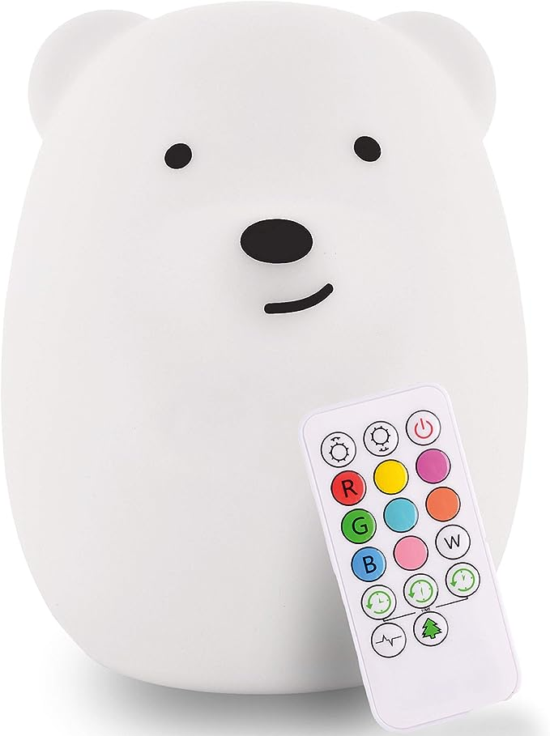
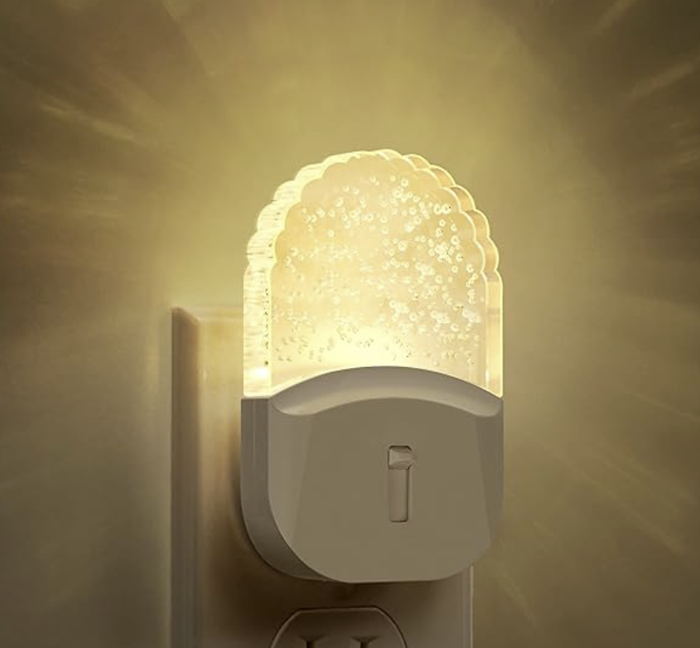
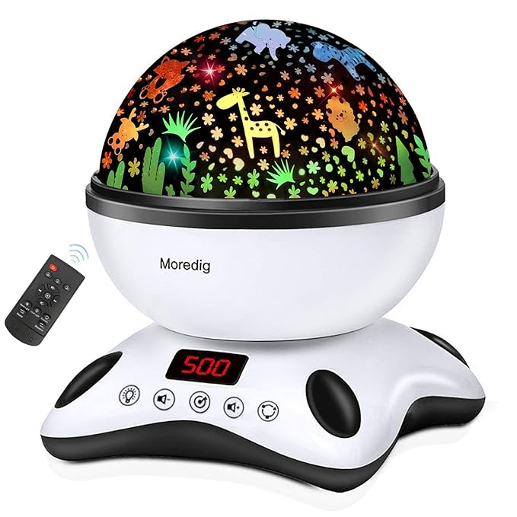
Market Comparisons
$24.99
$11.99
$38.99
sdmay24-22
sdmay24-22

Slide 4
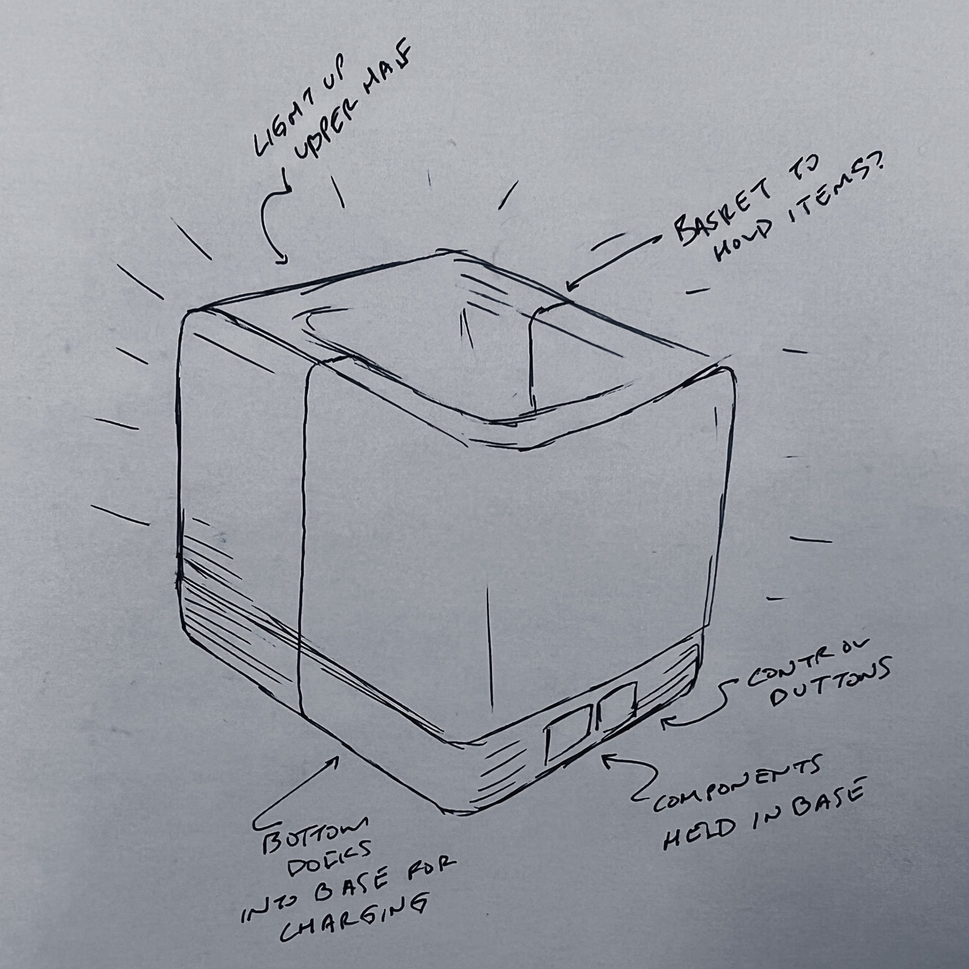
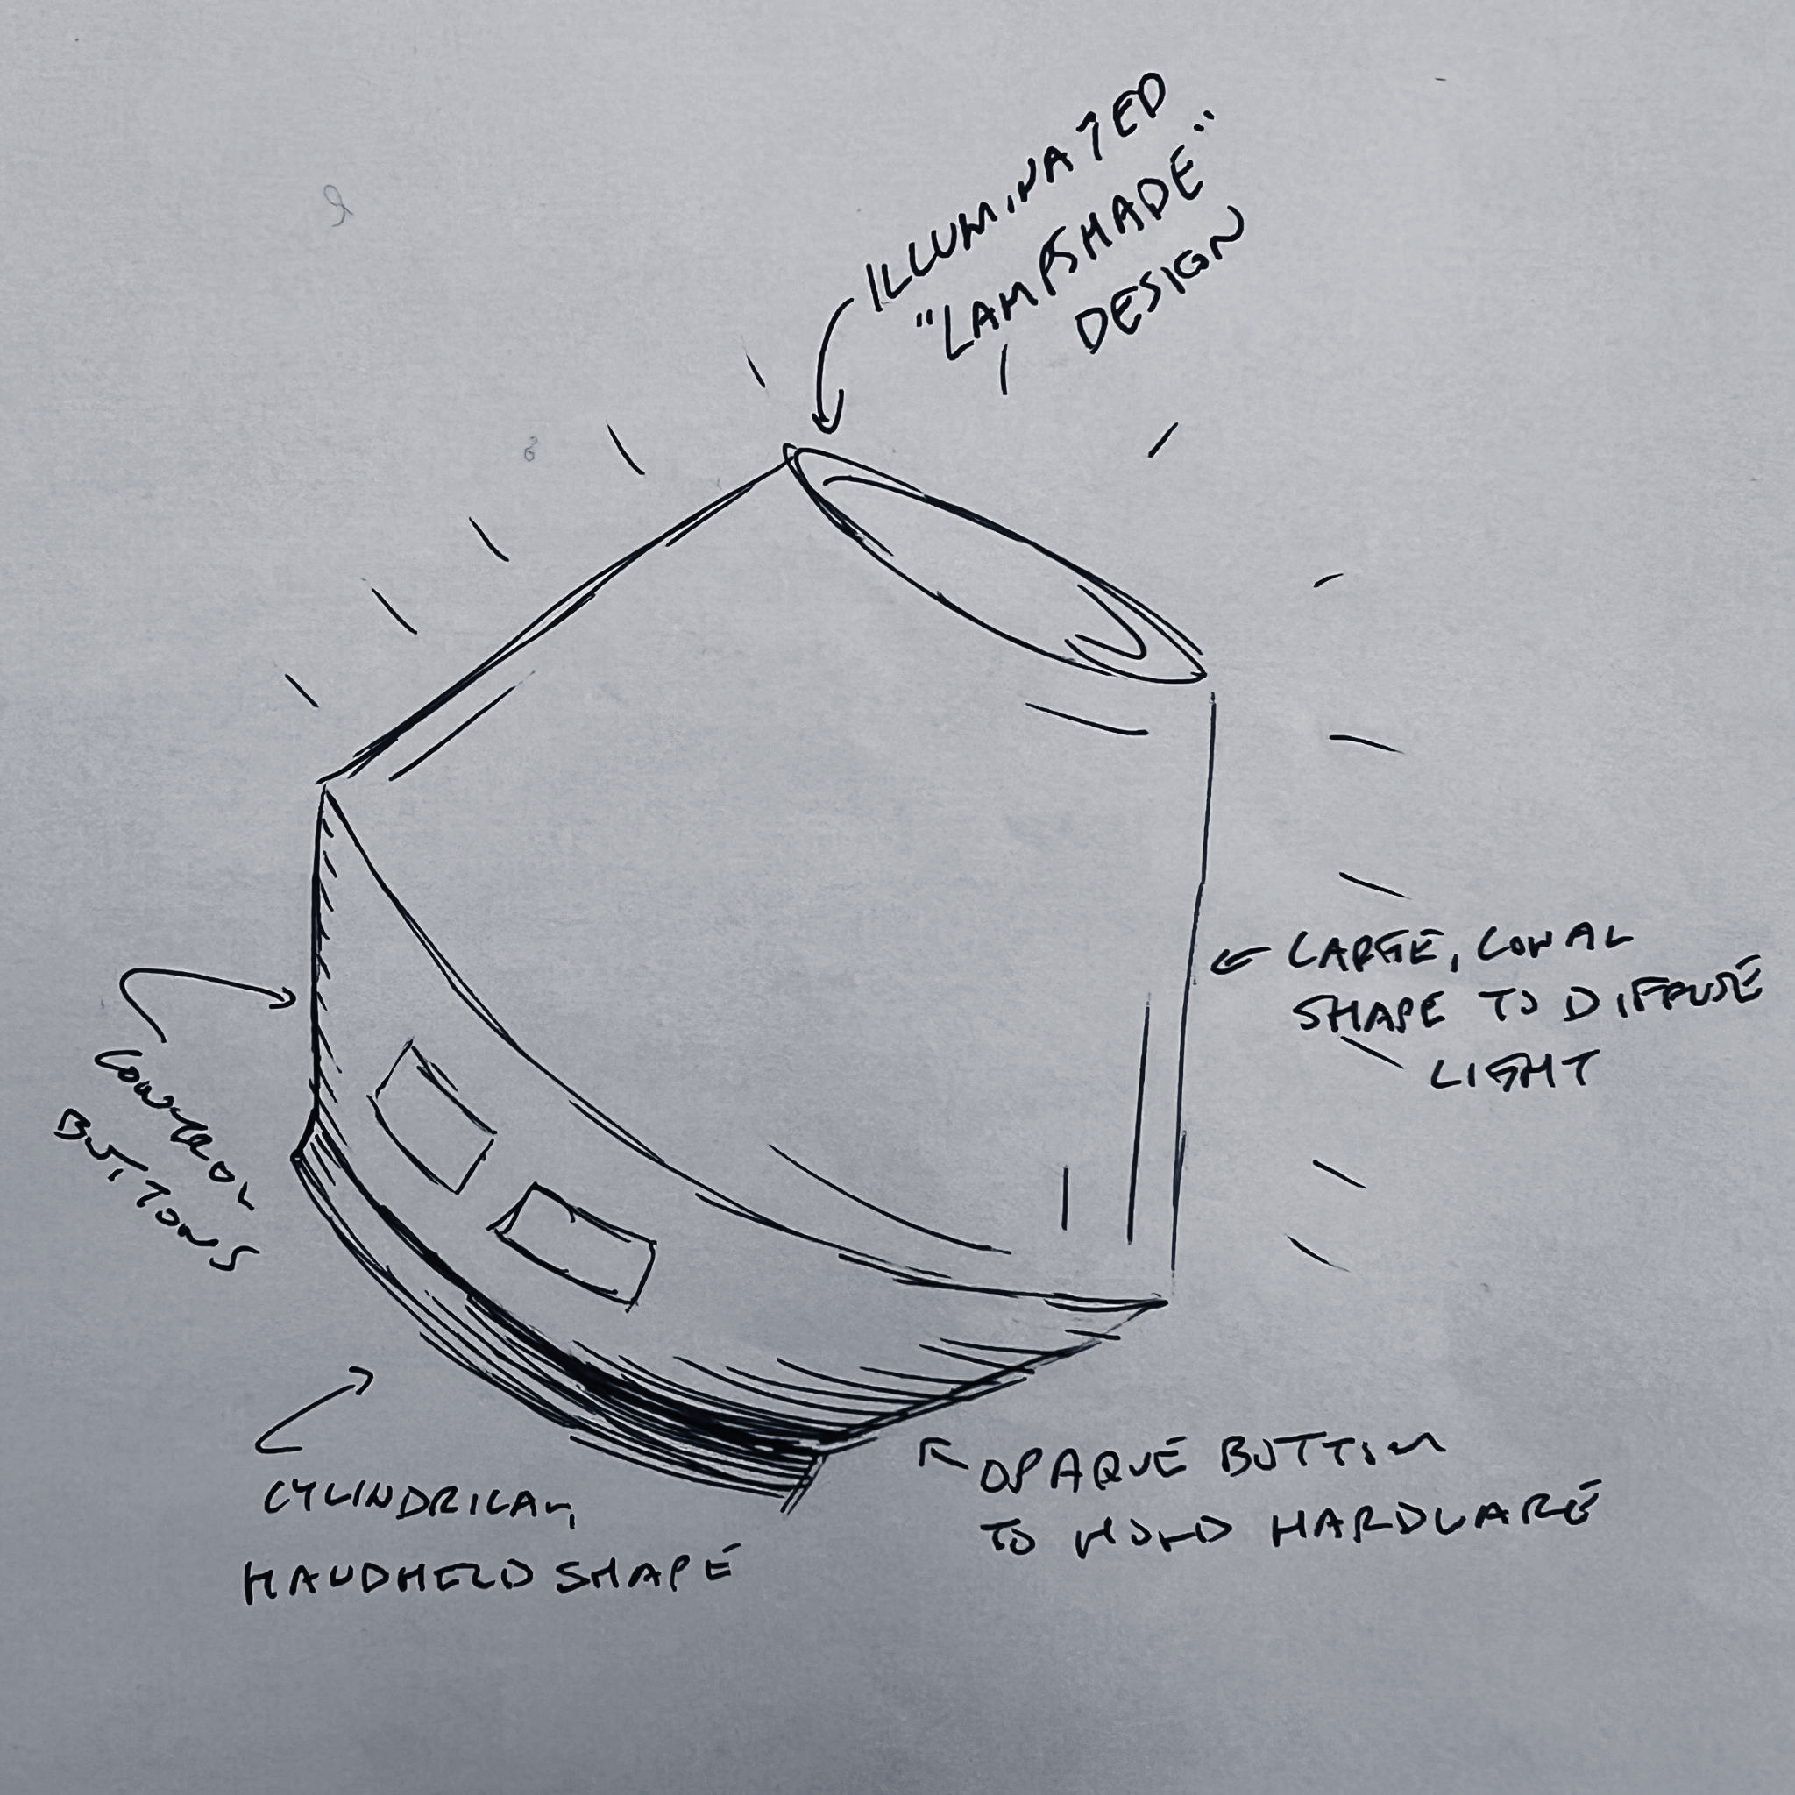
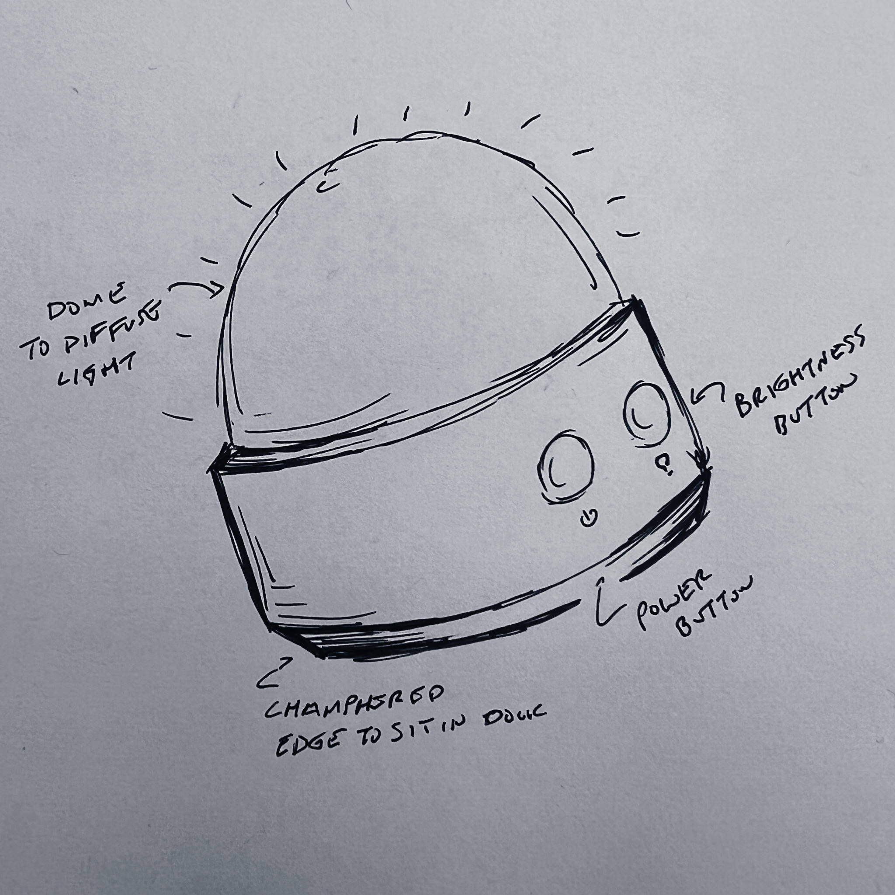
Conceptual Design Sketches
Design 1
“Basket”
Design 2
“Lampshade”
Design 3
“Gumdrop”
sdmay24-22
Notes:
Our design is still mostly in the brainstorming phase but we have a few designs made. The target audience is our current customer as well as ourselves. This is unique because we have few clients so our design can be tailor made to be interesting and explore new ideas.

Slide 5
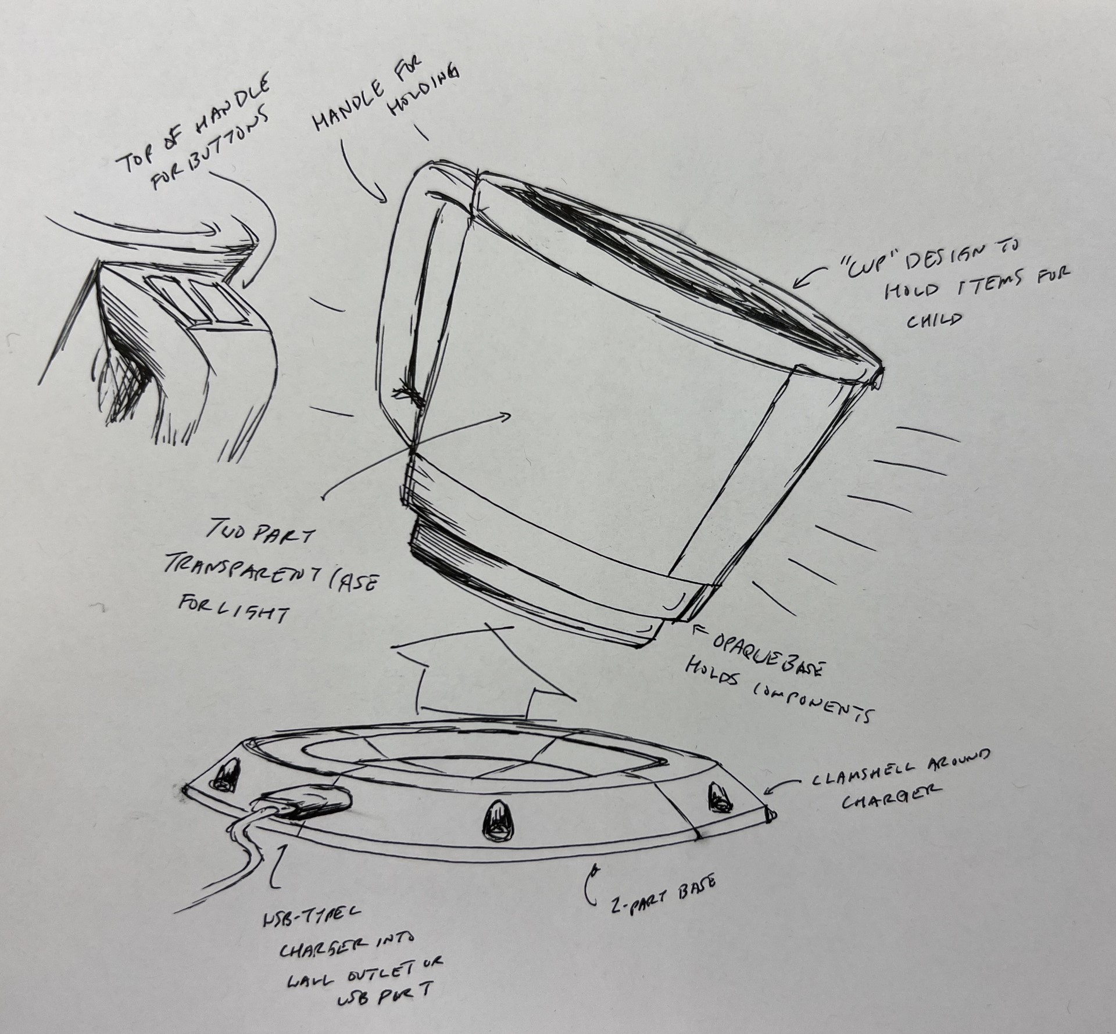
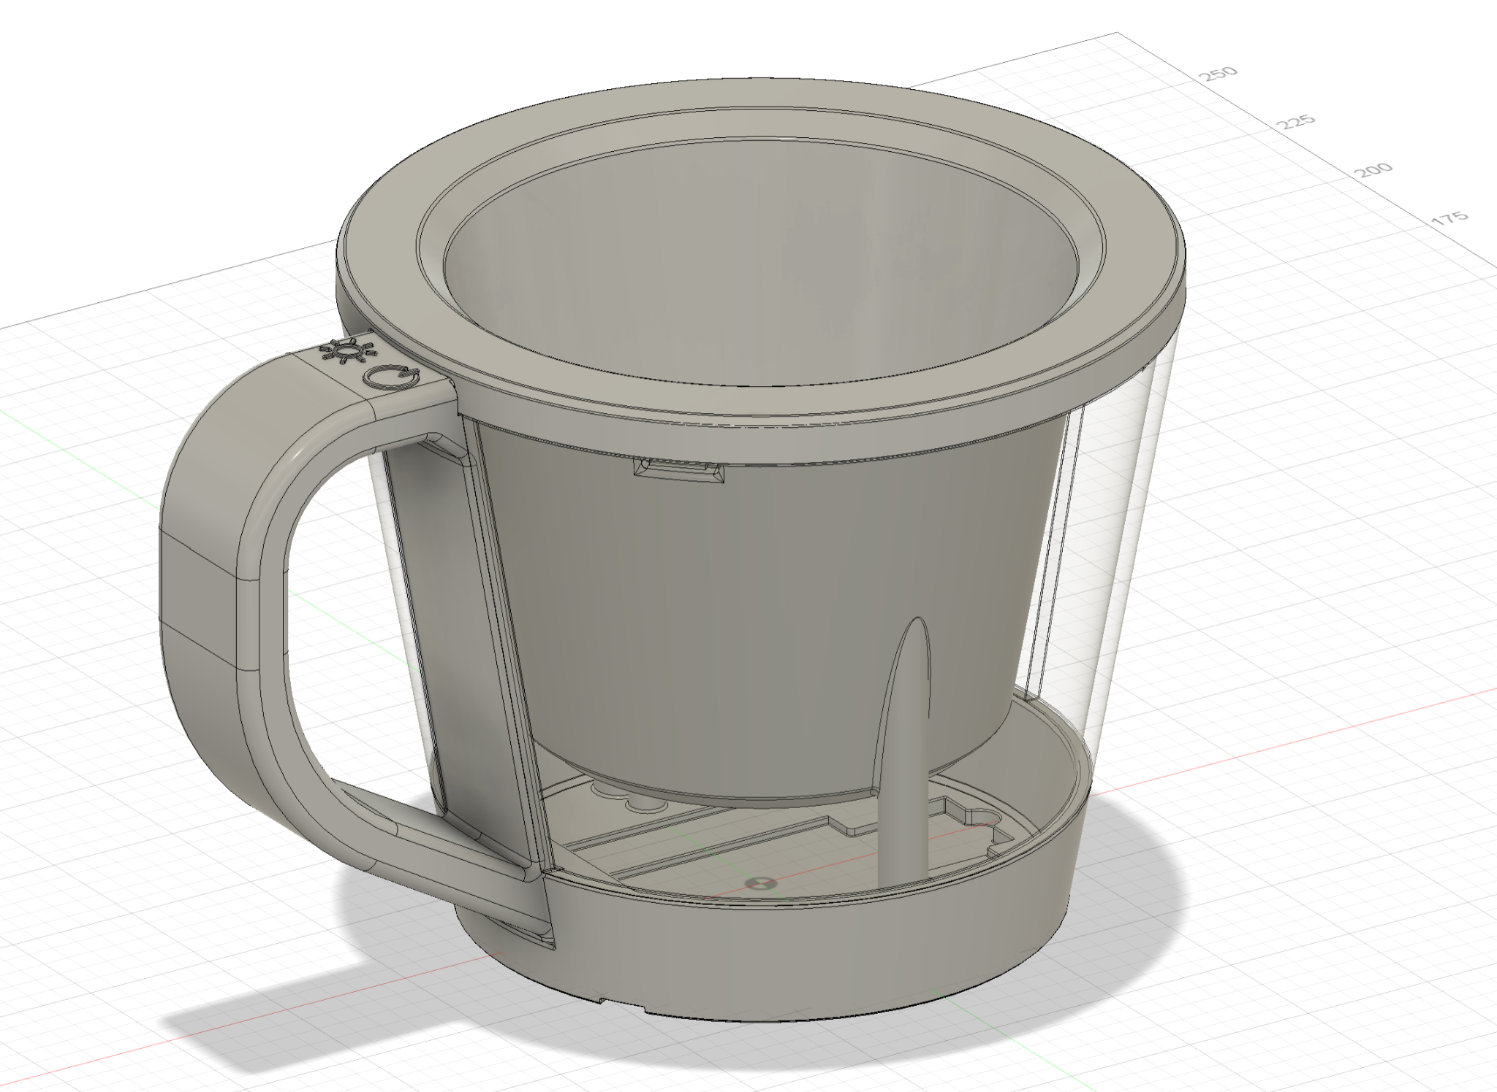
Project Vision
sdmay24-22
Notes:
What is the project attempting to accomplish?
The goal of this project is to create a night light for our customer. Specifically one that is wirelessly charged, has a long battery life, and brightness can be changed by the press of a button.
Who Cares? Whose life will be improved? Use cases?
This project is for our customer as a personal design and while it may not have the impact goals of other projects this gives us a unique case to create something that all of the group members can make and use as well as the customer. This project will improve the lives of all the users as a convenient way to deploy a light source has many applications outside of the main nursery light application it was designed for. These other cases include a flashlight when power is out, a garage light when working on cars or snowblowers, and when walking outside in the dark.

Slide 6
Final Prototype Design

Slide 7
Circuit Layout
sdmay24-22

Slide 8
Demonstration

Slide 9
Testing Plan
Tests include physical testing and measurements, user interface testing, and total functional testing.
Unit Testing
Touch Sensor: Testing material and thickness that it will work through
Light Strip: Measure current draw at different light levels
Wireless Charger: Measure Voltage at various distances between coils
Arduino Nano Every: Testing onboard LED and uploading functionality to the main board
Interface Testing
Arduino -> Touch sensor interface: Testing performance through materials
Arduino -> Light strip interface: Test ability to change brightness and dim over time
Wireless charger -> Lithium-polymer battery interface: Test connection between battery and circuit to ensure lowest usage rate
sdmay24-22

Slide 10
Testing Plan
Tests include physical testing and measurements, user interface testing, and total functional testing.
Integration Testing
Verify Circuits: Confirm individual circuit functionality
Voltage, Current, and Compatibility: Test battery compatibility
Battery Performance: Ensure three-day regular use support
Arduino Connection: Validate compatibility with Arduino
Modular Testing: Use smaller modules for progressive testing
Working Script: Compile modules for battery charging, LED control, brightness adjustment, and self-sleep mode
System Testing
Circuit Design: Measuring current draw and temperature of components
Software Design: Using the touch sensors and LED strip to test code functionality to meet all the requirements
Physical Design: Making sure the components fit into the enclosure and it is easy to use and assemble
sdmay24-22

Slide 11
Testing Plan
Tests include physical testing and measurements, user interface testing, and total functional testing.
Regression Testing
Test existing features after adding new functionality to ensure previous functionality is maintained
Ensuring the critical features, the touch sensor and LED strip, continue to work to keep basic functionality
Acceptance Testing
Client Engagement: Maintain client alignment.
Requirement Consistency: Ensure original meeting requirements remain
Aim for tangible testing outcomes
Battery: Validate three-day minimum normal use and charging functionality
User-Friendly Design: Assess outer housing ease of use and assembly
Programmability & Scalability: Confirm easy operational changes
Heat Safety: Verify safe heat output
sdmay24-22

Slide 12
Work Progress - Overview
Semester 1
Designed main circuit according to provided specs
Tested individual components and full software implementation
Industrial Design brainstorming of different designs
Stress testing
Semester 2
Circuit finalization and software updates
Rapid prototyping of project housing testing / manufacturing
Hardware installation and testing

Slide 13
Challenges and Solutions
Circuit Design issues
Replaced and remastered circuit to work with new components for reliability
Battery management issues
Component performance issues
Housing manufacturer sourcing/fidelity
Finding and sourcing materials to fit the design and time constraints of the project
Wall thickness for proper light diffusion needed to be tested
Component sizing
Circuit design requires small and reliable components
Communication with Client
Ensuring that the client is involved with all aspects of the design process

Slide 14
Thank you

